Slide 1


Slide 2
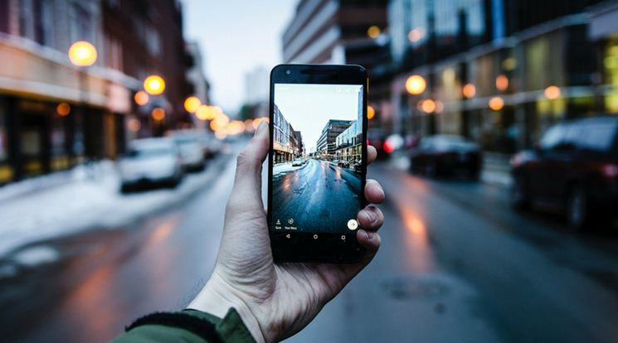
MOBILE
Team Leader: Muzammal Hussain
Presented by: Dcoding Team
Notes:
© Copyright Showeet.com – Free PowerPoint Templates

Slide 3
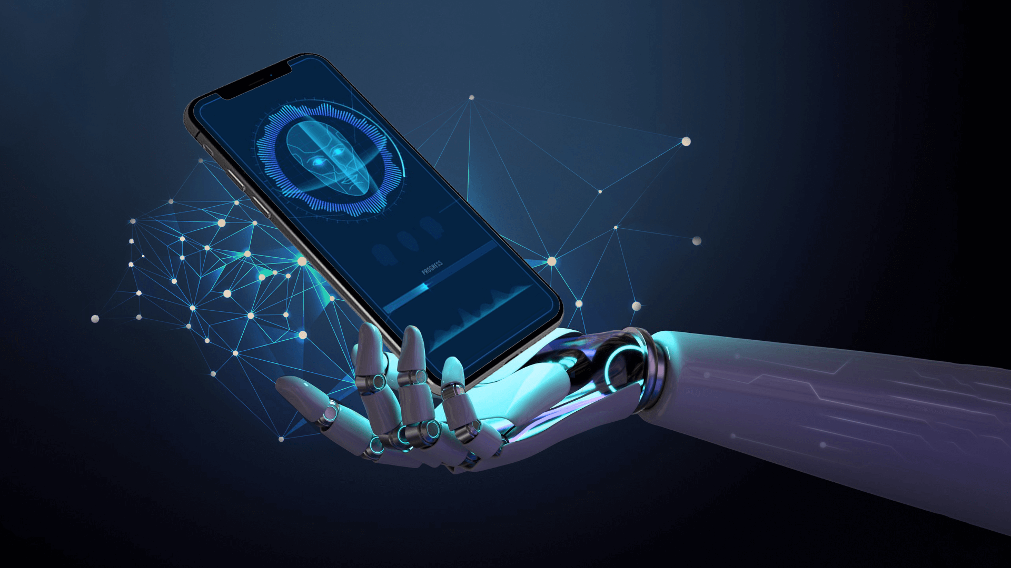
MOBILE
What is Mobile
History of Mobile
Benefits of Mobile
Disadvantages of Mobile
Modern Uses of Mobile
Safe Usage of Mobile
3

Slide 4
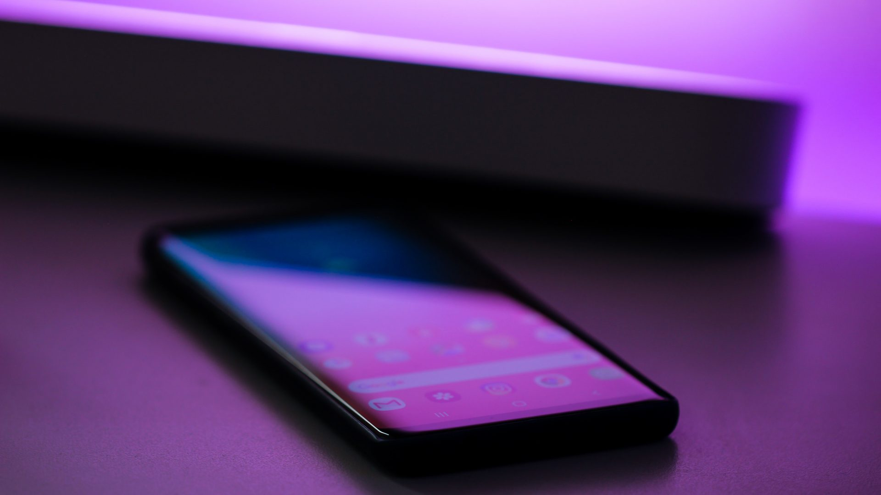
What is Mobile
A mobile is an electronic device used for communication, internet, and entertainment.
It works through wireless communication
.
Notes:
© Copyright Showeet.com – Free PowerPoint Templates

Slide 5

History of Mobile
The first mobile phone was invented in 1973.
Early mobile phones were large and heavy, but now smartphones are common.
Notes:
© Copyright Showeet.com – Free PowerPoint Templates

Slide 6
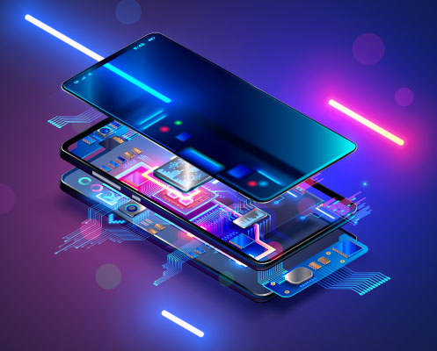
Benefits of Mobile
✔ Fast and easy communication ✔ Access to the internet and social media ✔ Education and online learning ✔ Entertainment: Games, music, and videos
Notes:
© Copyright Showeet.com – Free PowerPoint Templates

Slide 7

Disadvantages of Mobile
Affects health if overused
Wastes time and can be addictive
Privacy and security risks
Notes:
© Copyright Showeet.com – Free PowerPoint Templates

Slide 8
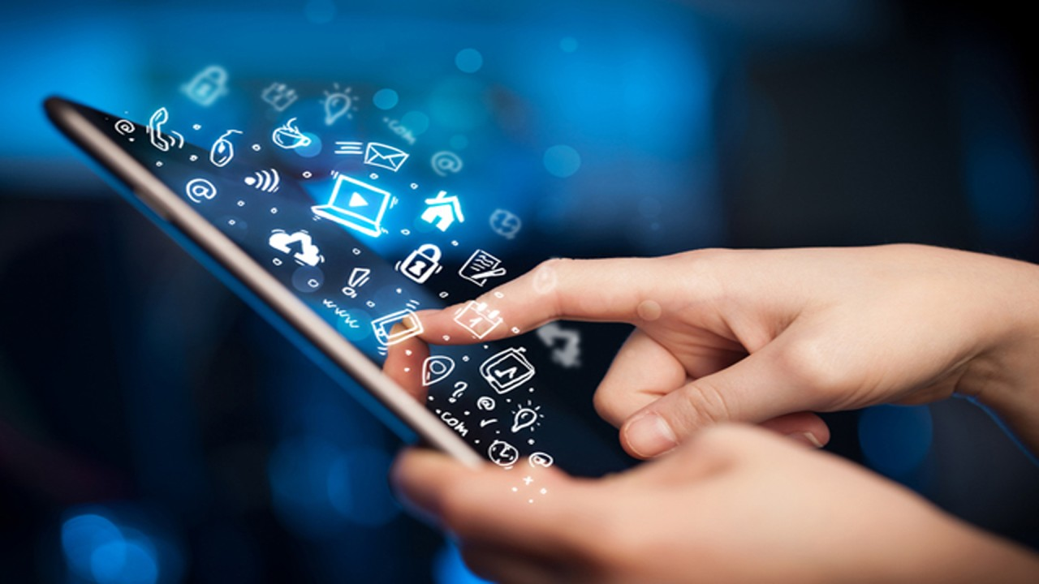
Modern Uses of Mobile
E-commerce and online business
Digital payments and banking
Smart apps and artificial intelligence

Slide 9
Safe Usage of Mobile
Use it for a limited time
Avoid unnecessary apps and websites
Protect privacy and data
Notes:
© Copyright Showeet.com – Free PowerPoint Templates

Slide 10

Large Image slide
Notes:
© Copyright Showeet.com – Free PowerPoint Templates

Slide 11

THANK YOU
.

